Slide 1
Preparing For an Extended Trip
(What You Need to Know, Before You Go)
Ali Kingston

Slide 4
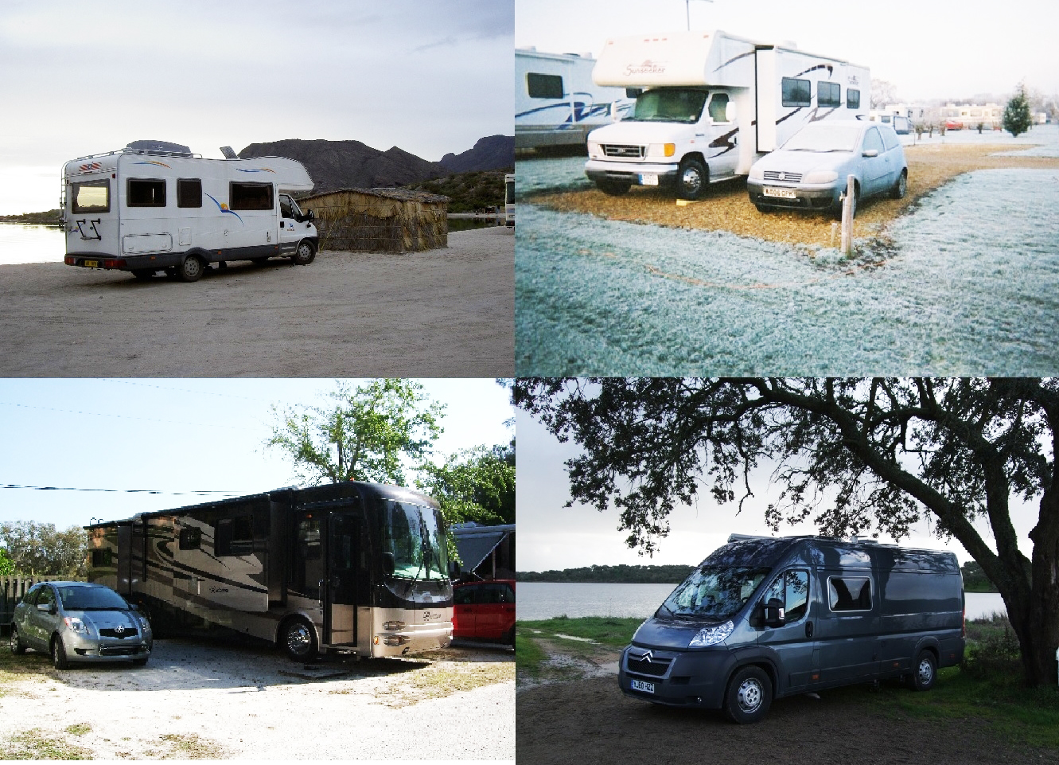

Slide 5
WE DIDN’T!!

Slide 6
Ever Been On An Extended Trip?
Ever been on a long trip? (Longer than three months?)
Planning one in foreseeable future?
Impossible dream with nightmare potential?

Slide 7
Seems boring when planning a trip of a lifetime
Great for big decisions

Slide 8
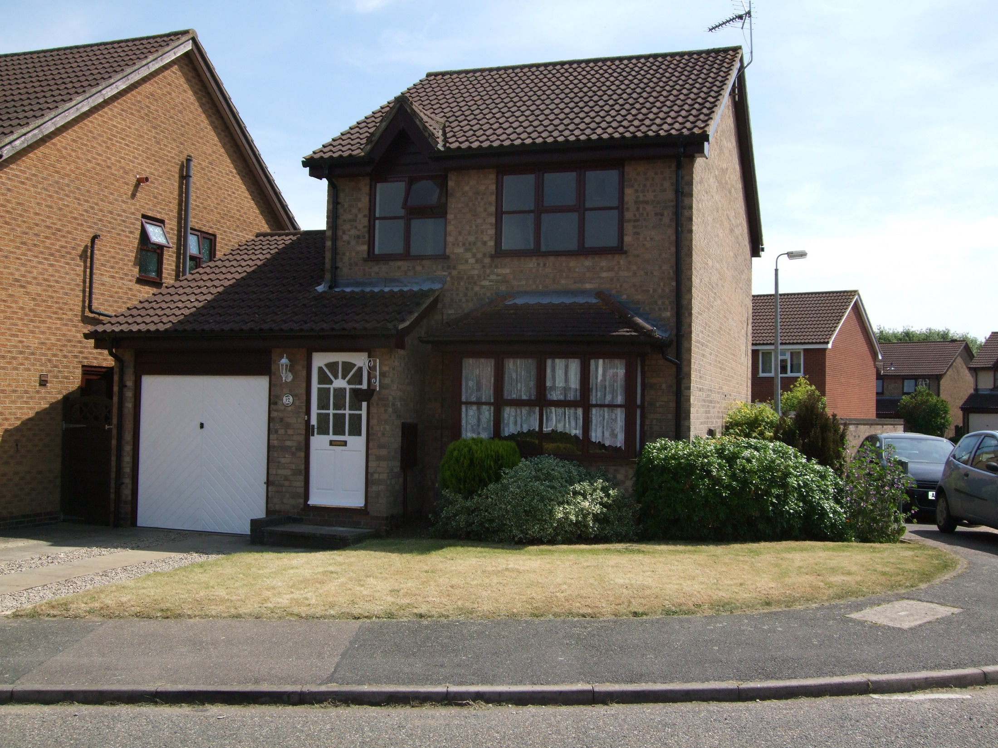
What do you do about your home at home?

Slide 9
• Leave it empty
• Rent it out
• Sell and downsize
• Sell up completely

Slide 10
No Fixed Abode
Things don't work out
Local Authority Housing
Private rental
Housing ladder

Slide 11
Security
Bills – council tax & water rates
Central heating
Damp
Gardening

Slide 12
Renting
Gives income
(Taxable)

Slide 13
Potential Minefield
Non-payment
Breakages
Neglect
Landlord responsible for repairs
Annual bills (gas certificates & insurance)
Agency fees
Residential Landlords Association

Slide 14
Address
Correspondence (breakdown cover, travel, health, motorhome/vehicle insurance)
Driving licence
Vehicle registration
Banking
Mobile phone
Income tax

Slide 15
Post
Redirection Service
2 years
Trustworthy friend/relative
Agency
Expensive
Post Office Box
DVLA & insurance companies require bricks and mortar premises
Remember to cancel unnecessary subscriptions and junk mail

Slide 16
Banking
Online
Set up before departure – proof of residence
OR
Set up direct debits & standing orders before departure
Trustworthy individual for one off bills
Remember to inform credit card company of countries en route.

Slide 17
On The Road

Slide 18
Stay Legal
? Covered for full-timing with vehicle insurance
Check allowable trip duration
Road Tax, MOT (if applicable).
Authorities can (and do) check
Passport, V5, MOT certificate, paid road tax
No valid MOT, ? Insured in event of accident
Only test recognised in UK is a UK test
Combine MOT journey with habitation check & family visits
Visit AA and RAC websites for specific country driving guides

Slide 19
Brand New Motorhome
Don't book overseas travel until you have taken delivery.
Like a live baby, due date and delivery aren't the same
Inform dealership in case of warranty issues
Test all systems before departure

Slide 20
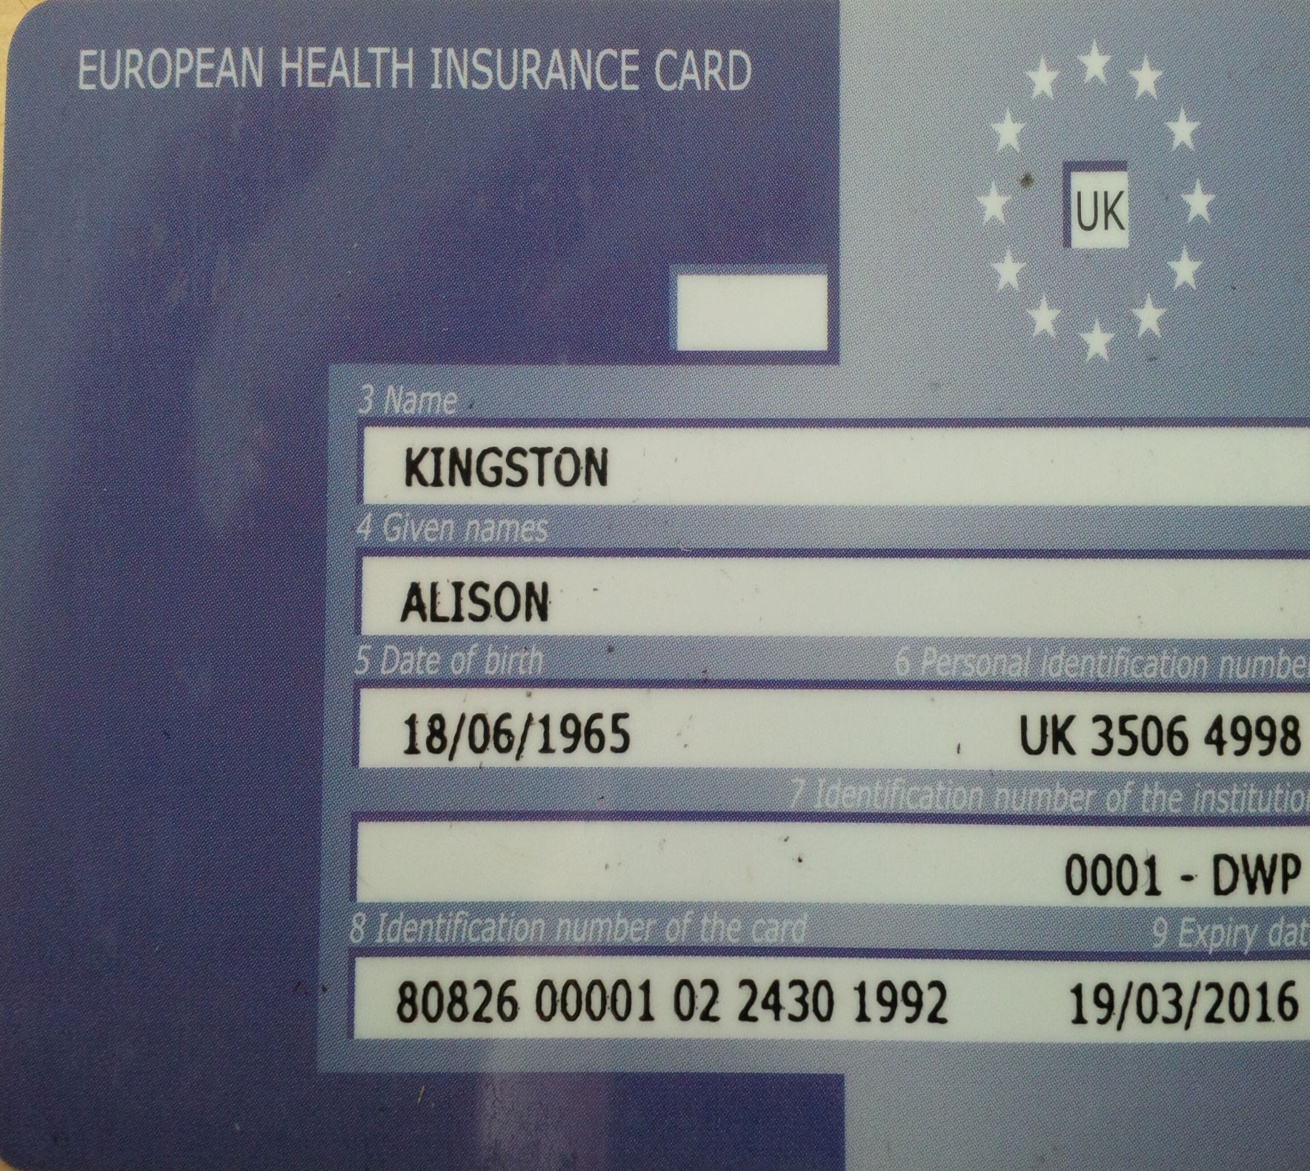
Health Issues

Slide 21
• European Health Insurance Card (EHIC)
• Private Health Insurance
• Medication
• Routine check ups

Slide 22
Travelling With Pets

Slide 23
Skanka in Training

Slide 24
Travelling Pets
Dogs, cats, parrots, budgerigars
Give away/rehome, leave with housesitter
Dogs give security at home and abroad
Check with Department for Environment, Food & Rural Affairs, and Animal and Plant Health Agency (DEFRA)
Pet passport
Inoculations
Veterinary Checks

Slide 25
Budget
Way of life, not holiday
Mike's ledger (Fuel, LPG, campsites, food, site seeing, ferries, sundries)
Research fuel costs, record exchange rates for future planning.

Slide 26
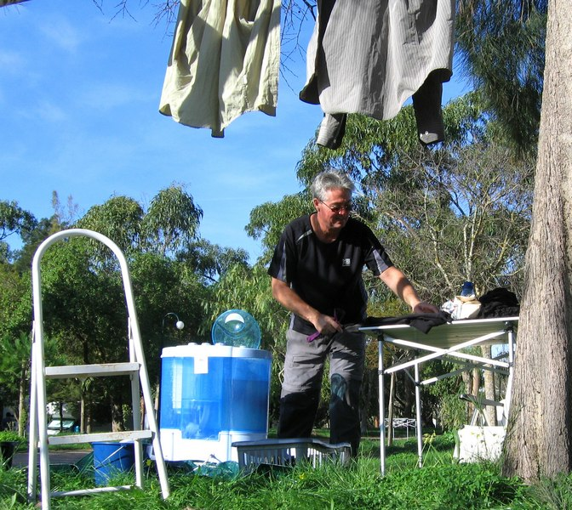
Save Money – Do Your Own Laundry (or get your husband to do it)

Slide 27
Communication
• Overseas roaming charges
• Unlocked mobile phone
• Wi-Fi (basic survival requirement)
• Skype

Slide 28
What To Pack
The Balance
Weight – Space Taken – Necessity
Prioritise
Legal e.g. Safety triangle, fire extinguisher.
Essentials e.g. tool kit, camping equipment
Seasonal change of clothes
What you need and what you want to take aren't the same thing!

Slide 29
Payload
Base vehicle licenced to carry a weight limit
Limited by driving licence

Slide 32
What Are You Waiting For?

